Slide 1

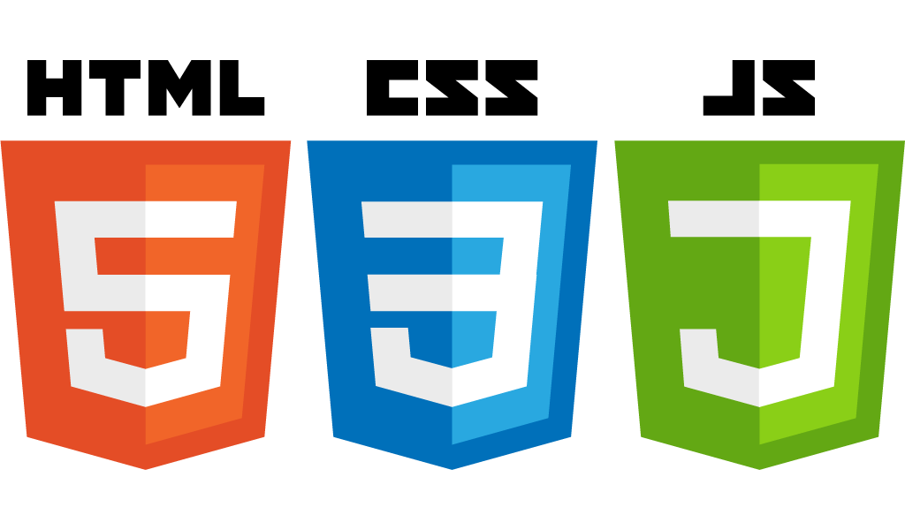




DevopsBuddy Architecture
Startup-ready web skeleton with Spring Boot, HTML5, CSS3, Javascript/JQuery, Bootstrap, Stripe and AWS

Slide 2
In this lecture…
The big picture
What is the user journey?
What are the business capabilities?
High Level Architecture
How is our system organised?
What are the different layers?
How do they collaborate with one another?
Package Architecture
Help us keep our code organised

Slide 3
The importance of Architecture
Architecture is fundamental for the delivery of any IT system, even in an Agile context. It helps with:
Consistency
Clarity of vision and direction
Maintainability
Simplicity
Internal and External Communication
Elegance

Slide 4

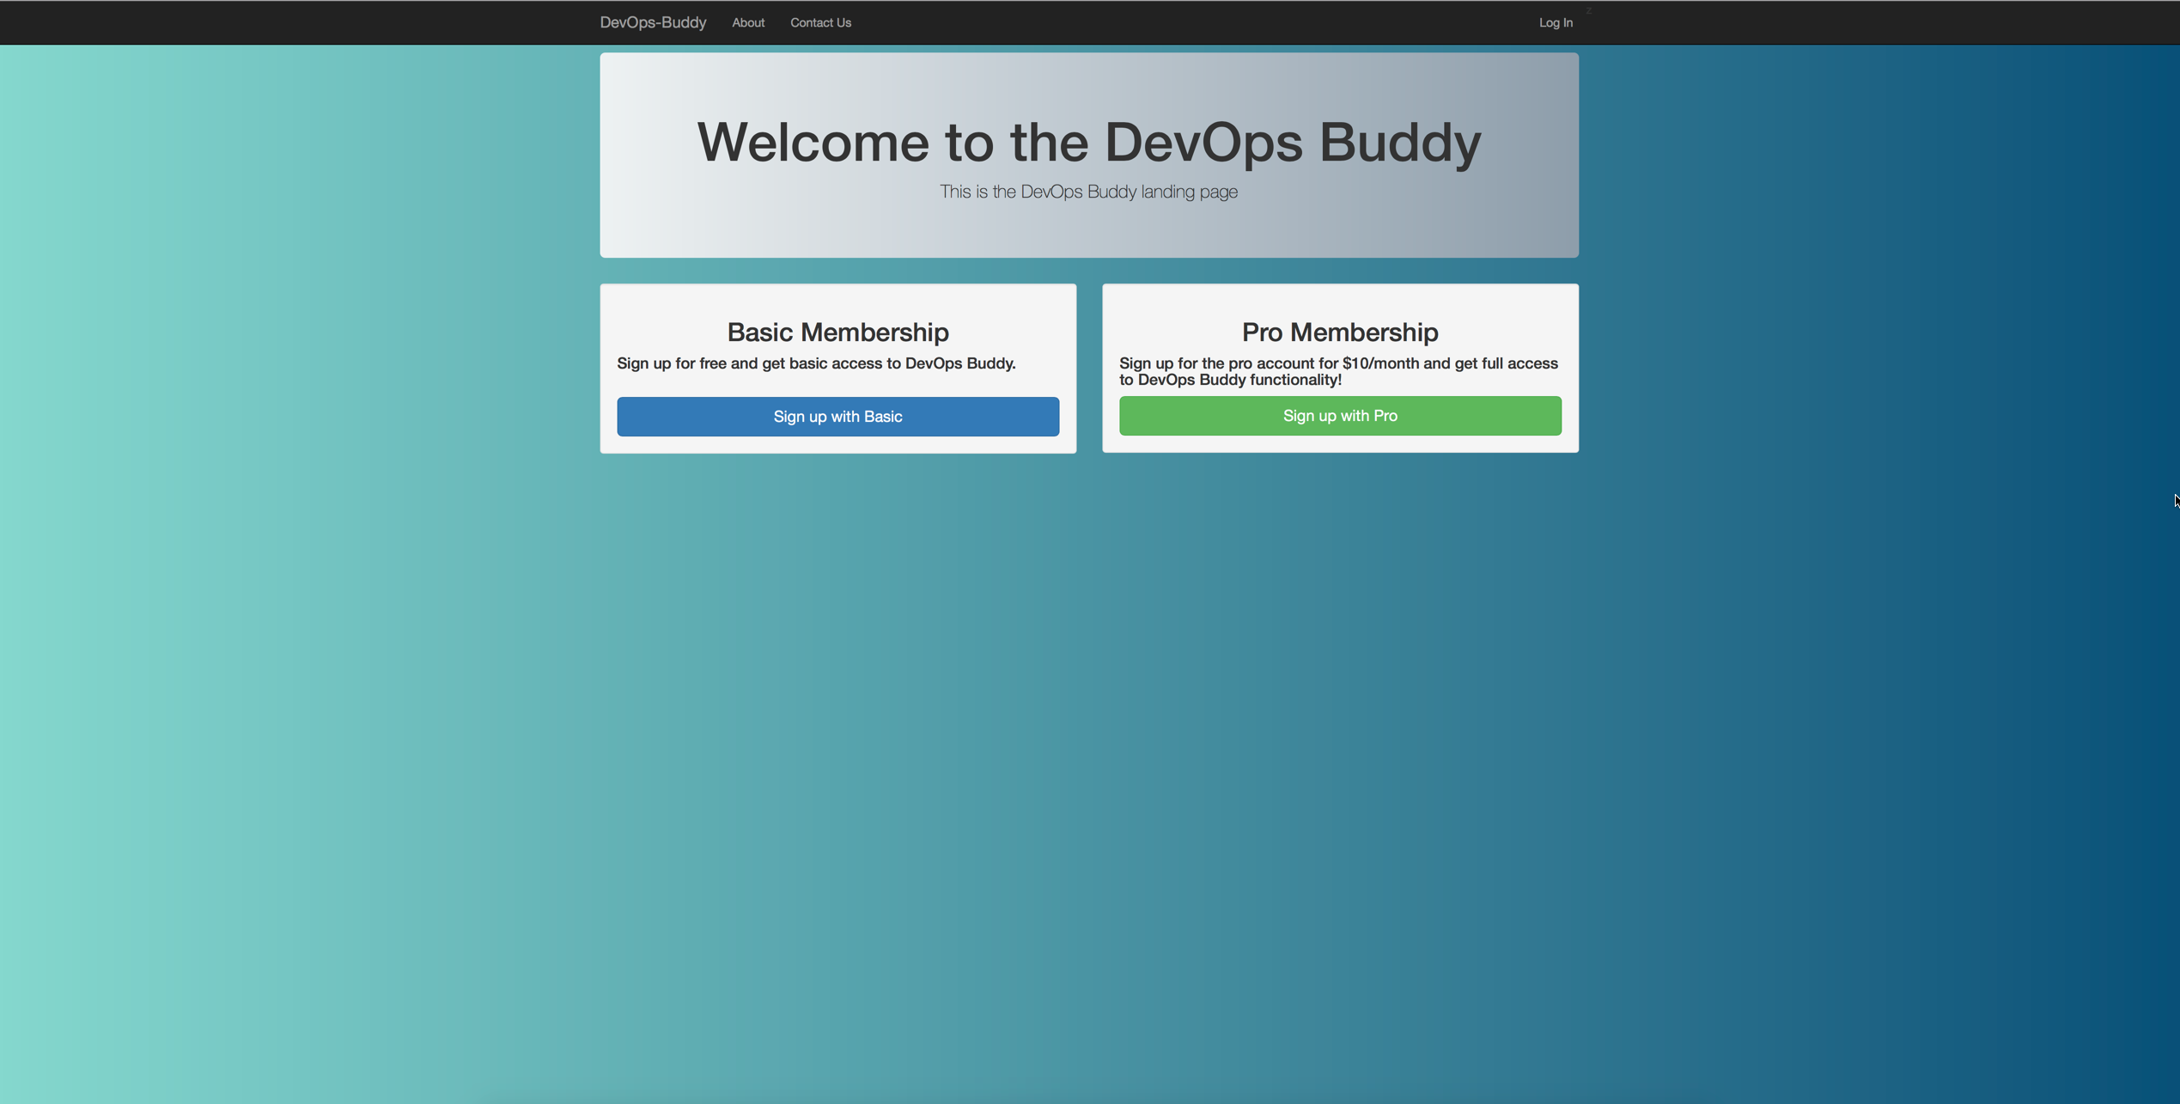



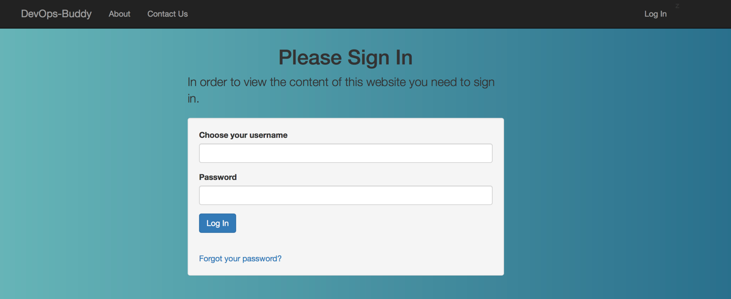
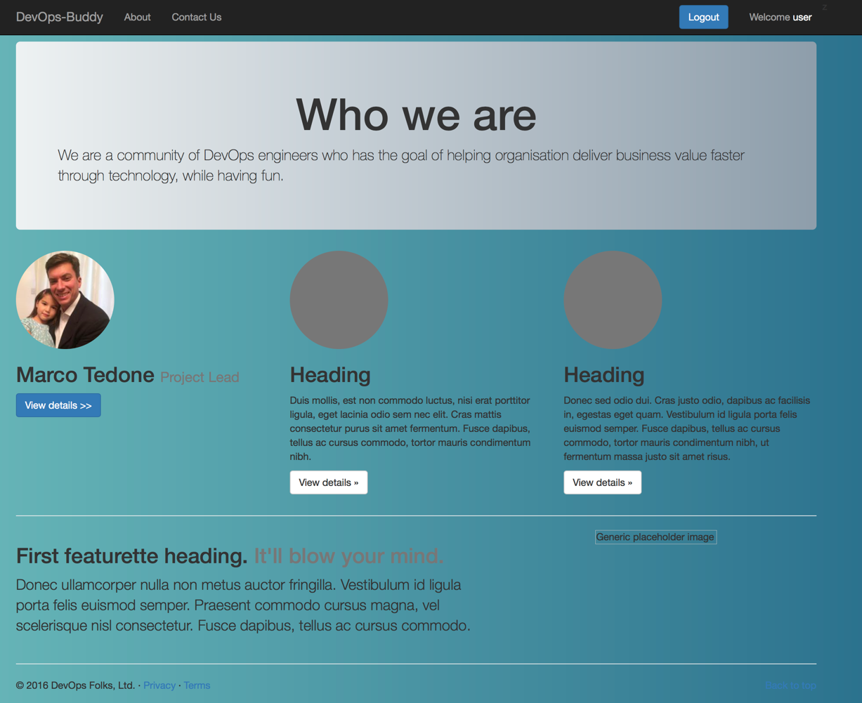
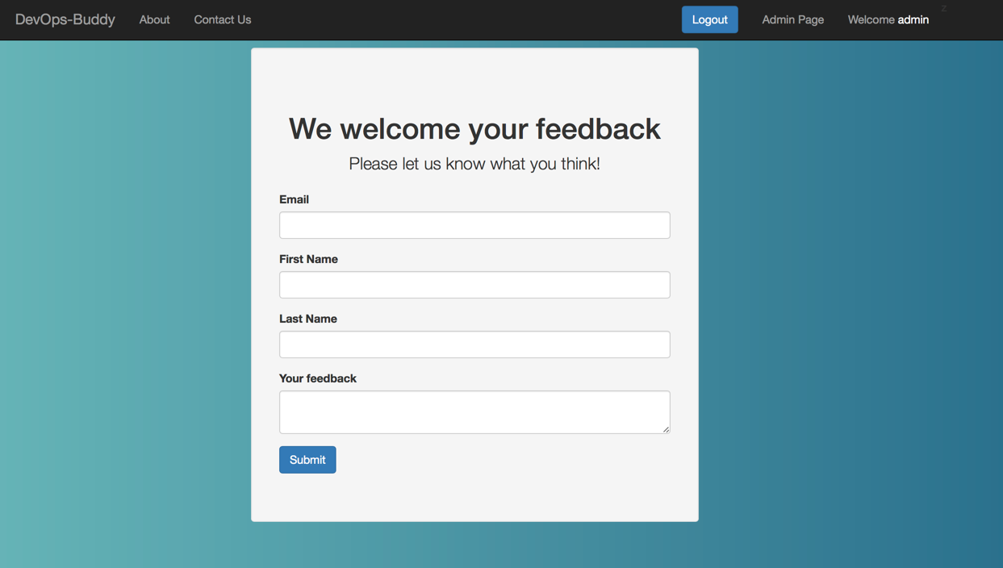

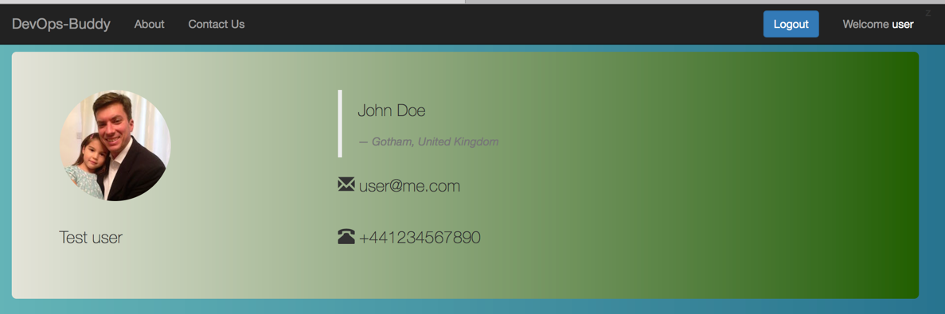
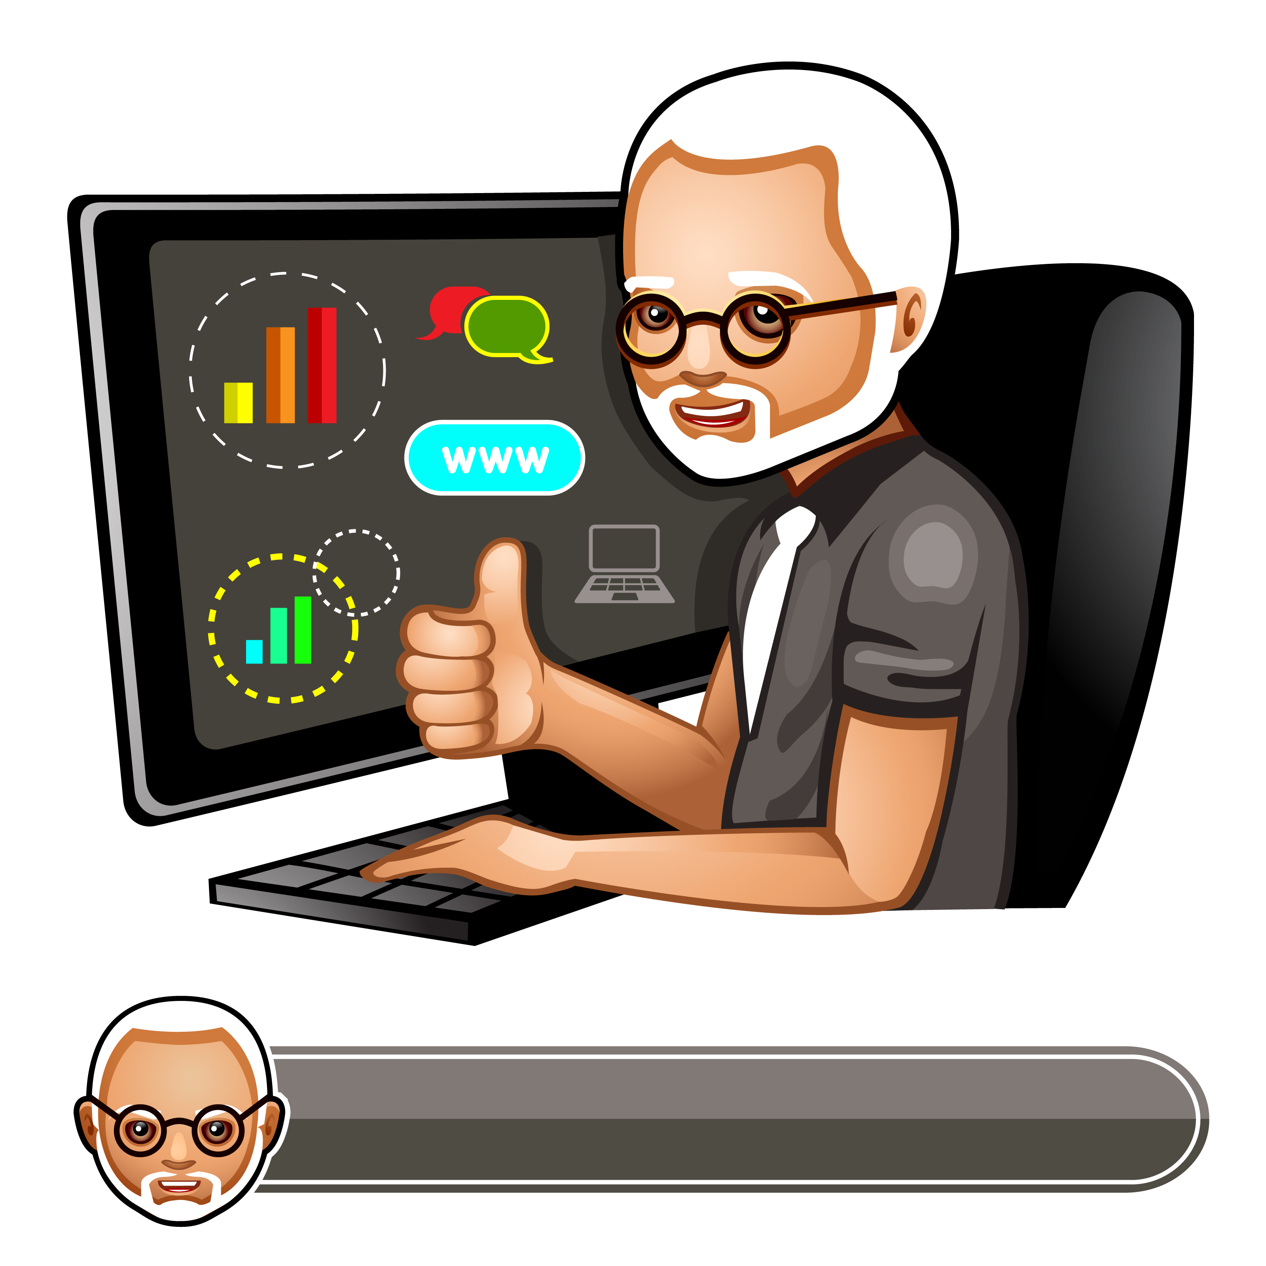


The big picture
Store profile image to AWS S3
Basic
Signup
Pro
Store / Retrieve customer data to /from the data store
Login / Forgot Password
Jenny
Check your company info
If Pro Account set up a Pro Plan with Stripe
Send feedback
Spring email
View profile page
Create the selling content
You

Slide 5




High Level Architecture
Web Layer
Controllers
Internationalisation
Front-end Domain
Spring Security
View Layer
Service Layer
Front Controller
Mail Service
S3 Service
Stripe Service
User Service
Persistence Layer
Advices
Back-end Domain
Repositories

Slide 6
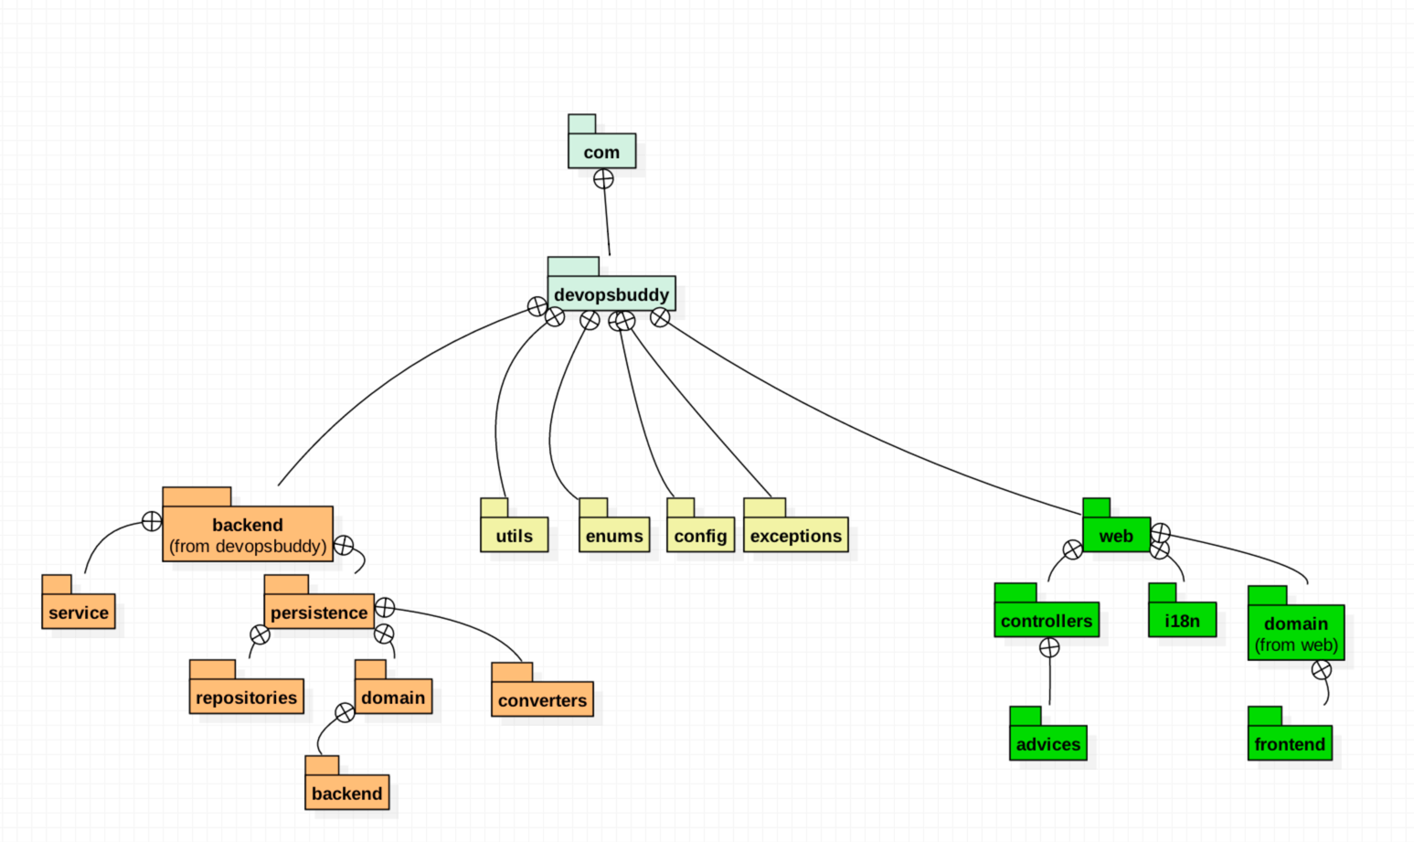
Package Architecture

